Slide 1

Xamarin App Development Getting Started with Native X-Platform Development
Slides and Code online here:
https://github.com/KeithJRome/MagicEightBall
Keith Rome
VP Technical Services
Xamarin Certified Developer and 2016 Microsoft MVP
rome@wintellect.com

Slide 2
@AtlCodeCamp
httpS://AtlantaCodeCamp.com/2016

Slide 3




Platinum Sponsors

Slide 4







Gold Sponsors

Slide 5





SWAG Sponsors
Silver Sponsors

Slide 6


Wintellect and Xamarin
Microsoft Gold Partner
Xamarin Premier Consulting Partner
Multiple Microsoft MVPs and Xamarin Certified Engineers on Staff
Broad knowledge of the Xamarin platform, especially with Xamarin Forms
We offer a range of engagement models, from project kick-starts to full development
We also offer instructor-led training as well as on-demand training via Wintellect NOW

Slide 7
Introduction
Why Mobile, and why now?
For many companies, it’s no longer enough to have just a desktop or web app
Users expect to be able to access their systems from mobile devices
There are several options available to developers:
Native Applications using Native SDK Tools from Apple, Google and Microsoft
Mobile-friendly Web Apps
So-called “Hybrid” Web-based Apps
Native Applications build using alternative toolchains such as Xamarin and NativeScript
Despite what some may claim, ALL of these options have scenarios where they outperform the others

Slide 8
What is Xamarin All About?
Simply put, Xamarin allows you to build Native mobile apps for Android and iOS using C#
Code is compiled by the C# compiler, but linked and packaged by the native SDK tools
Benefits:
Comparable performance to Native
Comparable memory usage to Native
Single language across platforms (C#)
Ability to use Visual Studio for iOS/Android
Better visual designer tools in some cases
Answers on StackOverflow for Java/Obj-C tend to also be valid for Xamarin C# projects
Drawbacks:
Still requires a Mac for iOS apps
Tools can sometimes be buggy
Can be difficult to troubleshoot build problems
Can be difficult to get emulators working for all platforms at the same time
Xamarin Classic lets you use C# for iOS/Android, but you still program against native UI SDK
Xamarin Forms provides a simpler abstraction on top of Classic, targeting both at the same time

Slide 9
History of the Platform
Roots are with Ximian / Mono from 2001-2001 timeframe
MonoTouch launched in 2009
Xamarin (as an organization) founded in 2011
Xamarin.Android released in 2011, MonoTouch renamed to Xamarin.iOS
Xamarin.Mac released in 2012
Xamarin 2.0 released in 2013
Xamarin 3.0 released in 2014, with Xamarin Forms support
Xamarin acquired by Microsoft in 2016, Xamarin Forms becomes open-source

Slide 10
How to get Xamarin
If you have an MSDN Subscription, you already have a license to use Xamarin for all platforms
On Windows, it is included in the Visual Studio Installer as an optional component
On Mac OS X, you will need to download Xamarin Studio instead
Uses same license as Visual Studio on Windows
Also Included with Community Editions of Visual Studio, with most features intact
You still need the Android SDK and Java SDK to build Android apps
You still need XCode on a Mac to build iOS and Mac apps

Slide 11
About the Development Tools
If you only intend to build iOS and/or Android apps, then you don’t need to run Windows or Visual Studio unless you want to
When using Windows and Visual Studio, you will need access to a Mac with XCode
Builds are done using the XCode tools
Simulators also run on OSX, although there is a new “Windows” iOS Simulator available
For Android there are multiple options:
Google’s Emulators on Mac or Windows (doesn’t get along with Hyper-V)
Visual Studio’s Emulator on Windows (requires Hyper-V)
Xamarin Android Player on Mac or Windows (discontinued)
Genymotion Emulators (not free)

Slide 12
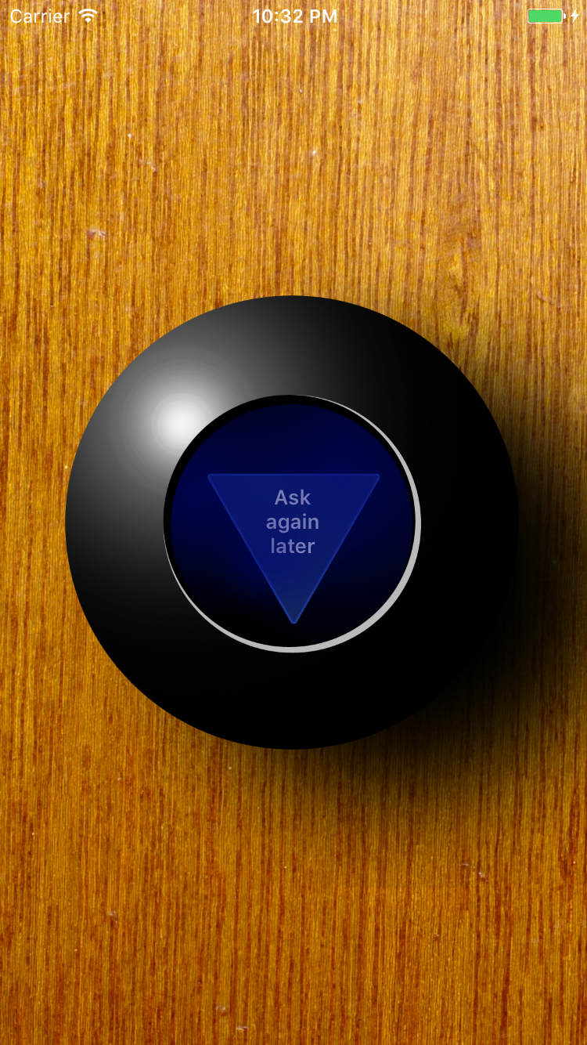
A Mobile App Concept
Let’s build a ”real” mobile app
The infamous “Magic” 8 Ball – ask a question, shake it, and get your answer from a wise prophet
We will build it using Xamarin Forms to get to market ASAP on multiple platforms
All work will be done using Visual Studio where possible
Let’s see if we can get this done before our session is up!

Slide 13
Getting Our Hands Dirty in VS
Demo Time!
Notes:
Launch Visual Studio
Before creating project, show Xamarin Options dialog and point out how to connect to the Mac and troubleshoot Android SDK problems
Turn on Remote Simulator to Windows in Xamarin Options (only available if installed)
Be sure to connect to Mac’s IP Address and NOT name, otherwise Remote Simulator won’t work
Use the shortened login name, no spaces
Might need to start the simulator on OS X first
Create X-Platform project in Visual Studio
Blank XAML App (PCL)
Name it MagicEightBall.Mobile
Target UWP to Win10 Anniversary
Point out how the VS template includes UWP, Android, iOS - Xamarin Studio template on Mac OS X does not include UWP or other Windows project types
Remove the Windows Phone and Windows RT projects - We won’t target those (also remove from filesystem)
Update Xamarin Forms and UWP packages
Add simple UI page with a Label for answer and a Button to get answer

Slide 14
So, Let’s Talk About REST APIs
Next, we’ll take a look at the Azure-hosted ”Oracle” web service
We’ll add a very easy-to-use REST nuget package to our app
And we’ll wire it up to a very simple UI

Slide 15
Calling the Remote Service
Demo Time!
Notes:
REST API
Show the WebAPI 8-Ball service and demo making JSON calls to it (postman)
Add Refit package to solution (2.4.1 - explain why)
Update Newtonsoft.Json
Add simple service proxy interface for the service
Use Get() attribute from Refit on the method, make it return a Task
Add a class to instantiate the service proxy using RestService.For<T>()
Point out that we need to go add Microsoft.Net.Http package to PCL and UWP
Add the call to the service proxy, and add comment to add error checking / retry logic
Modify UI to update the Label with results from service
Name the button and label
Click handler on button
Disable button while async call is waiting
Set Label text to response
Set Label color based on Disposition
Run the app

Slide 16
Upgrading the UI
Our app has some basic functionality now
But visually, it kind of sucks
So let’s fix that by:
Adding a background image
Adding artwork layers for the 8-Ball itself
Adding artwork for the “answer” die
Helpful Link for figuring out artwork size in Xamarin Forms:
http://devcenter.wintellect.com/krome/understanding-native-image-sizing-in-xamarin-forms-apps

Slide 17
Revising the UI
Demo Time!
Notes:
Replace temporary UI with the new artwork
Don’t worry about multiple resolutions for now
Demonstrate the Forms Previewer window
Get text answers to appear correctly on the die
Tapping the ball should get a new answer
Demo the app on each device platform
Won’t work on Android since my environment is damaged

Slide 18
Summary
In this session, we covered quite a lot of ground:
Learned about the Xamarin Platform
Learned how to get Xamarin on our system
Created a new Cross-platform Xamarin App
Added the ability to call remote REST services
Updated the UI of our app with artwork
In the next session (after lunch), we will build some cool features into our app and go through the non-trivial process of preparing our app for the App Stores

Slide 19
Surveys and Prizes
Please complete the session and event surveys!
1 ticket per session survey
1 ticket for the event survey
1 ticket for completing the booth game
Drawing for prizes begins at 5pm in Q202

